Slide 1
EDUC 200C
Two sample t-tests
November 9, 2010

Slide 2
Review: What are the following?
Sampling Distribution
Standard Error of the Mean
Central Limit Theorem
Confidence Interval
Standard Error of the difference between the means
  Pooled variance

Slide 3
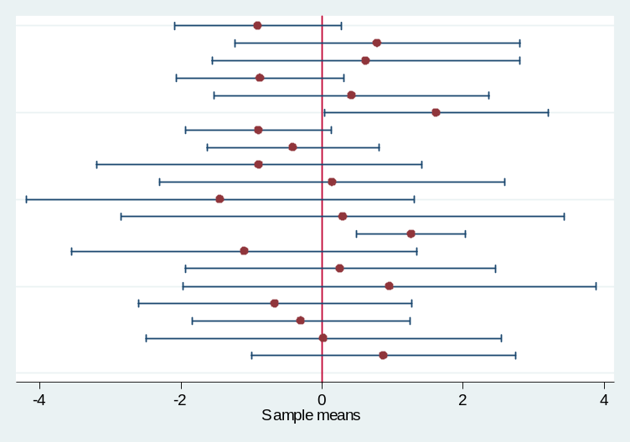
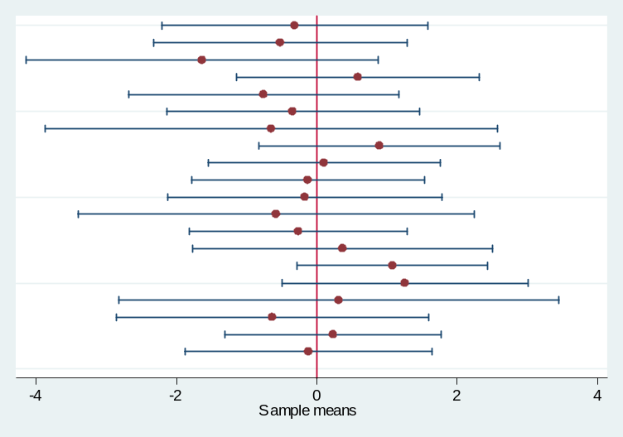
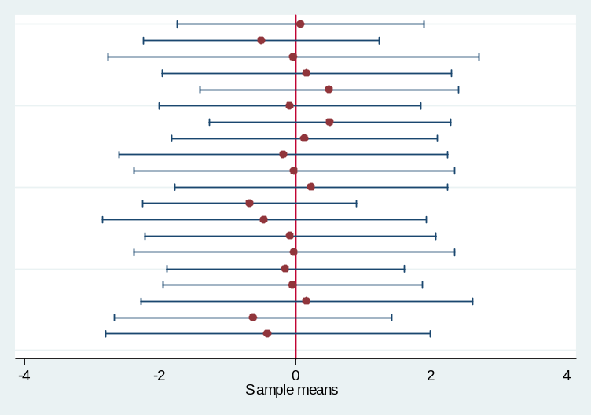
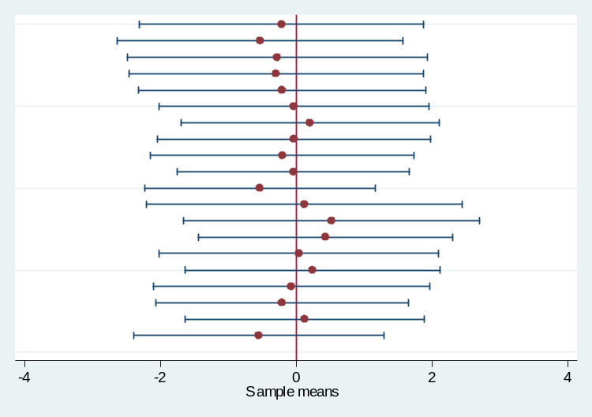
20 samples randomly drawn from a population with mean = 0 and sd = 2
N = 5
N = 10
N = 20
N = 50

Slide 4
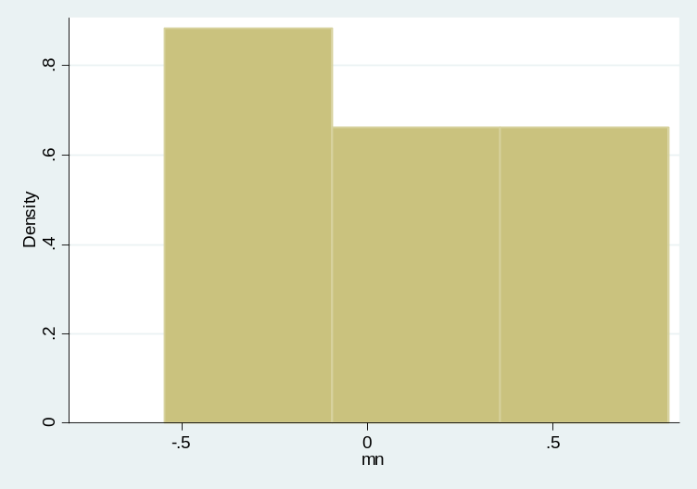
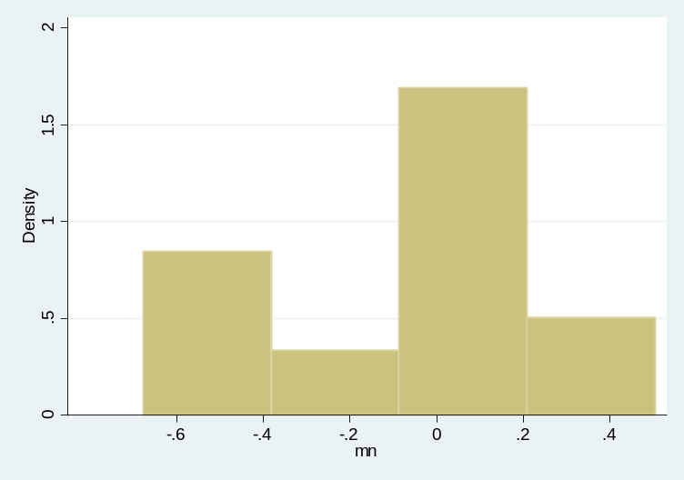
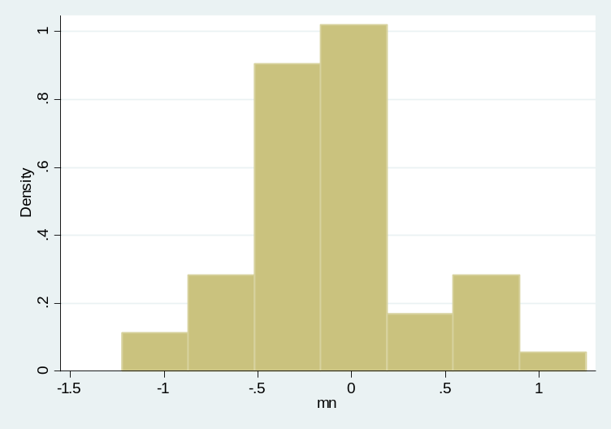
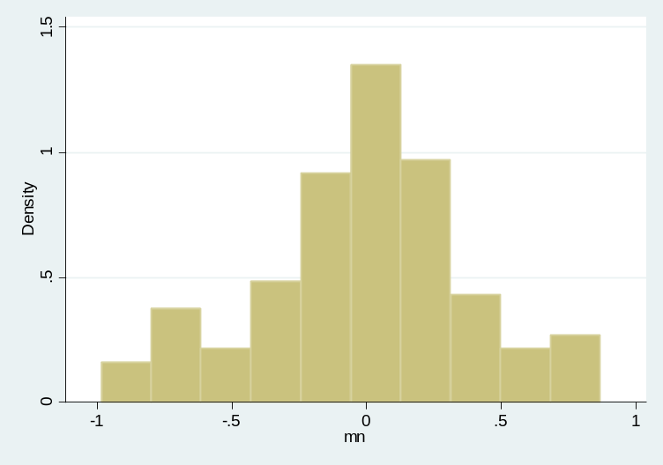
As the number of samples increases, the distribution of sample means approaches
a normal distribution with a mean equal to the population mean
10 Samples
20 Samples
50 Samples
100 Samples
Notes:
Draw a normal distribution on the board. Talk about how it’s possible to draw a really unusual sample, but it’s not likely. Spend time on this.

Slide 5
Hypothesis testing cheat sheet

Slide 6
Practice Problem 1
A high school social studies teacher decides to conduct action research in her classroom by investigating the effects of immediate testing on memory. She randomly divides her class into two groups. Group 1 studies a short essay for 20 minutes, while group 2 studies the essay for 20 minutes and then immediately takes a 10-minutes test on the essay. The results below are from a final exam on the essay, taken one month later:
  Set up the appropriate statistical hypotheses
  Perform the test (α=0.05)
  Draw final conclusions.

Slide 7
Independent sample t-tests
So far, we’ve talked about and calculated the difference in the mean of a certain variable between two independent populations.
  Here, “independent” tells us that there was no connection between the two groups we were comparing
Our test statistic took the form
This allowed us to make claims about how the mean of one population compared to the mean of the other.

Slide 8
Matched pairs t-tests
Used when the observations are not independent
  Same person measured twice
  Relevant connection between observation (e.g. parents and children)
  Observations deliberately matched on particular attributes (e.g. intelligence)
Tells whether the mean difference within observations is significantly different from the null hypothesis value (usually 0).

Slide 9
Matched pairs t-statistic
Based on how we’ve constructed our tests of significance so far, how would we go about testing a matched pairs hypothesis?

Slide 10
Matched pairs t-statistic

Slide 11
Stata
Performing a matched pairs t-test is the same as performing and independent samples t-test, just leave off the “unpaired” option
ttest var1==var2

Slide 12
Questions??

